Slide 1

The Role of Artificial Intelligence and Machine Learning in Cloud Platforms
CSA1514-Cloud Computing and Big Data Analytics
Guided by
Dr. R Latha
Presented by
Gnanesh Kumar Naidu (192371051)

Slide 2


OBJECTIVES
To study the integration of AI and ML technologies with cloud platforms.
To understand how cloud platforms support the development and deployment of AI/ML models.
To examine the role of AI and ML in data processing, predictive analytics, and automation.
To identify the benefits and challenges of implementing AI and ML in cloud environments.
To explore real-world applications and use cases of AI and ML in cloud platforms.

Slide 3
CORE TECHNICAL EXPLANTION
Artificial Intelligence enables cloud platforms to perform intelligent tasks such as decision-making, automation, and problem-solving.
Machine Learning uses data to identify patterns, learn from experience, and make predictions.
Cloud platforms provide computing power, storage, and resources to develop and run AI/ML models.
Data processing techniques collect, clean, and analyze large amounts of data for model training.
Trained AI/ML models are deployed on cloud platforms to provide predictions and intelligent services.

Slide 4
REAL WORLD APPLICATION
SMART HEALTHCARE:
AI and ML are integrated into cloud platforms for healthcare services.
Patient data is collected from medical devices and healthcare systems.
Data is securely stored and processed in the cloud.
Machine Learning analyzes patient data to identify patterns.
AI helps predict disease risks and supports medical decision-making.

Slide 5
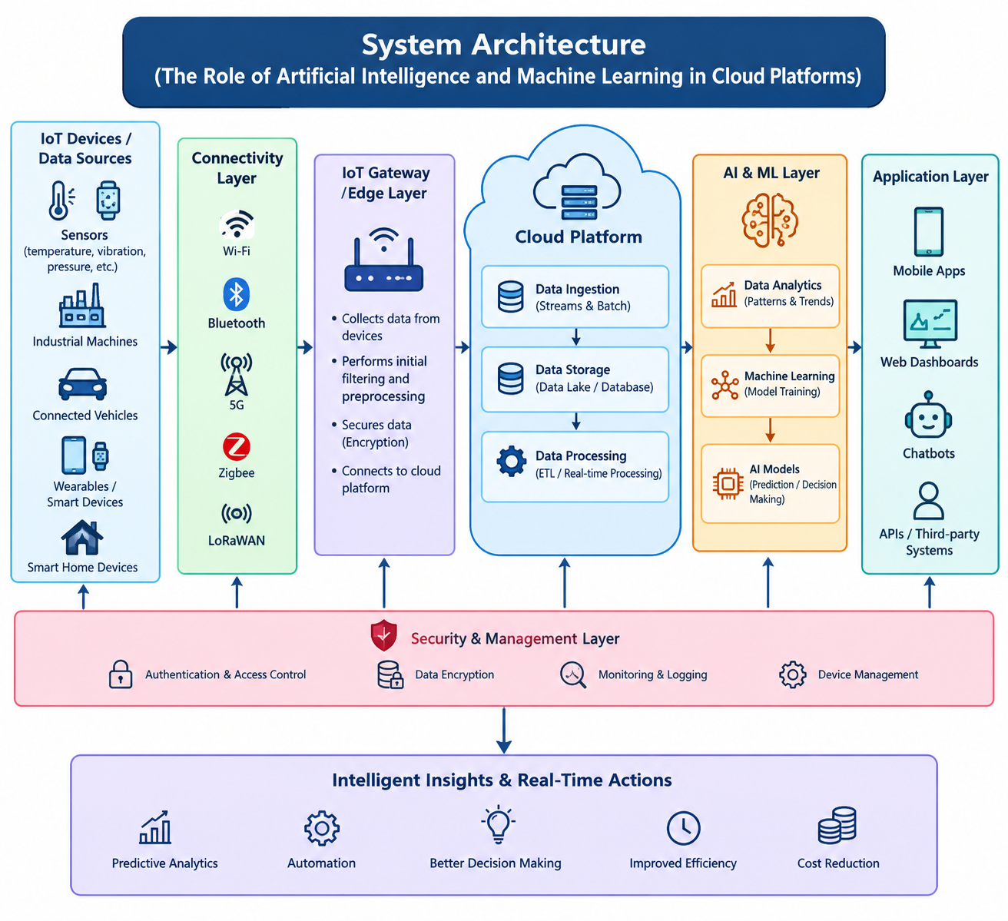
SYSTEM ARCHITECTURE

Slide 6
BENEFITS AND INDUSTRY RELEVANCE
Improves automation, real-time monitoring, and decision-making using AI and ML.
Provides scalable cloud storage, remote access, and efficient data processing.
Enables predictive analytics, reduces operational costs, and improves productivity.
Healthcare: Disease prediction and remote patient monitoring.
Manufacturing and Agriculture: Predictive maintenance and smart farming.
Transportation and Smart Cities: Traffic prediction, connected vehicles, and intelligent city management.

Slide 7
CHALLENGES
Protecting sensitive data from cyberattacks and unauthorized access.
Ensuring data quality and reliability for AI/ML model training.
Managing cloud computing costs and AI model deployment expenses.
Reducing delays in data processing and real-time predictions.
Handling large volumes of data and increasing user demands.
Maintaining model accuracy and preventing incorrect predictions.

Slide 8
CONCLUSION
AI and ML enhance cloud platforms by enabling intelligent automation and data-driven decision-making.
Cloud computing provides scalable storage, computing power, and resources for AI/ML applications.
These technologies improve efficiency, accuracy, and predictive analytics across industries.
Despite challenges such as security, privacy, and cost, AI and ML play a vital role in the future of cloud computing.

Slide 9


